Slide 1
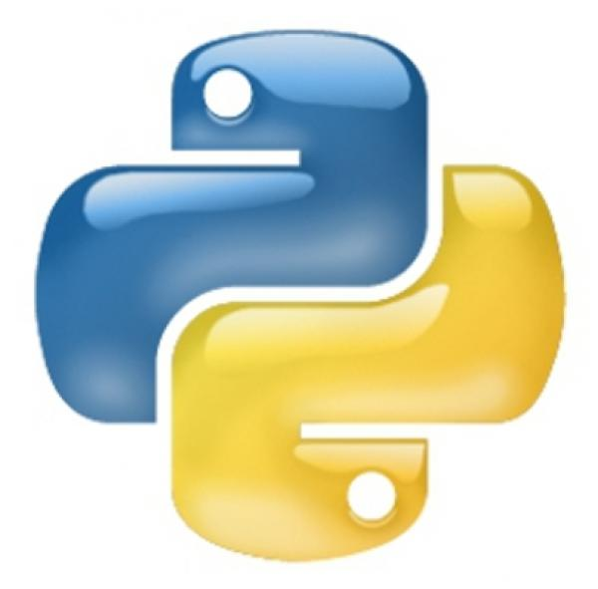
Web Scraping And Analytics With Python
View Mastering Python course details at http://www.edureka.co/python
For Queries:
Post on Twitter @edurekaIN: #askEdureka
Post on Facebook /edurekaIN
For more details please contact us:
US : 1800 275 9730 (toll free)
INDIA : +91 88808 62004
Email Us : sales@edureka.co

Slide 2
Objectives
At the end of this module, you will be able to
What is Web Scraping
BeautifulSoup Scraping Package
Scraping IMDB WebPage
PyDoop Package for Analytics

Slide 3
Web Scraping
Web scraping (web harvesting or web data extraction) is a computer software technique of extracting information from websites
Web scraping is a method for pulling data from the structured (or not so structured) HTML that makes up a web page
Most websites do not offer the functionality to save a copy of the data which they display to your local storage. We can only view them on the web
If we have to store them, we will need to manually copy and paste the data displayed by the website in the browser to a local file – This is a very tedious job which can take many hours or sometimes days to complete
Imagine getting data from google finance page to know historic information about multiple companies. We can simply automate the process with few lines of code and will get the desired result. If the information change, simply we have to rerun the code, instead doing manually again!!

Slide 4
Web Scrape - Why ?
Many websites do not provide an API (Unlike facebook, twitter etc). Web scraping is the only alternative to get data from them
A quick, easy and free way to gather huge data with considerably less effort
Saves manual effort of copying and storing data
If done manually, only way to keep them is in text format which again need to be converted to JSON or XML format for further processing

Slide 5
Web Scraping
Python has numerous libraries for approaching this type of problem, many of which are incredibly powerful
Popular web scrapping python packages:
Pattern
Requests
Scrapy
BeautifulSoup
Mechanize
In this course we are covering Beautiful Soup which is most popular in the lot
But these packages can work together too

Slide 6
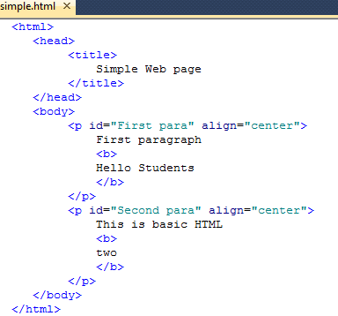
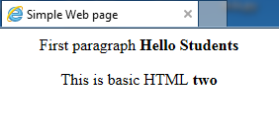

Typical HTML structure
Note: Save this file with a .html extension

Slide 7
BeautifulSoup Installation
If you run Debian or Ubuntu, you can install Beautiful Soup with the system package manager:
sudo apt-get install python-bs4
To install from PyPi:
easy_install beautifulsoup4
or
pip install beautifulsoup4
If you have downloaded the source tarball and want to install manually:
python setup.py install
Refer http://www.crummy.com/software/BeautifulSoup/bs4/doc/#installing-beautiful-soup to avoid any installation related errors and to install other useful packages like lxml parser

Slide 8
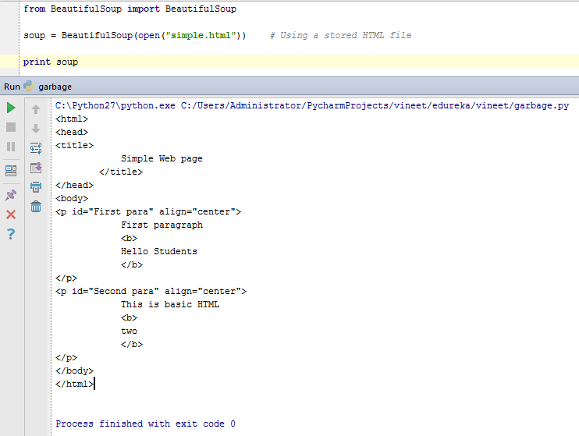
BeautifulSoup for Parsing a Doc
To parse a document, pass it into the BeautifulSoup constructor
We can pass in a string or an open filehandle
Example:
from bs4 import BeautifulSoup
# Using a stored HTML file
soup = BeautifulSoup(open(“simple.html"))
# Entire HTML doc can be passed
soup = BeautifulSoup("<html>data</html>")

Slide 9
Different Objects
Beautiful Soup transforms a complex HTML document into a complex tree of Python objects.
Example: soup = BeautifulSoup('<b class=“price">New Rate </b>')
Tag Object:
A Tag object corresponds to a HTML tag in the original document.
Attributes Object:
A tag may have any number of attributes.
The tag <p class=“price"> has an attribute “class” whose value is “price”.
You can access a tag’s attributes by treating the tag like a dictionary:
tag [‘class’]
Access attributes by .attrs:

Slide 10
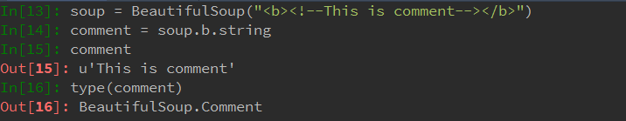
Different Objects(Contd.)
NavigableString Object:
Beautiful Soup uses the NavigableString class to contain bits of text within a tag:
Comments:
This is a special type of NavigableString Object:

Slide 11
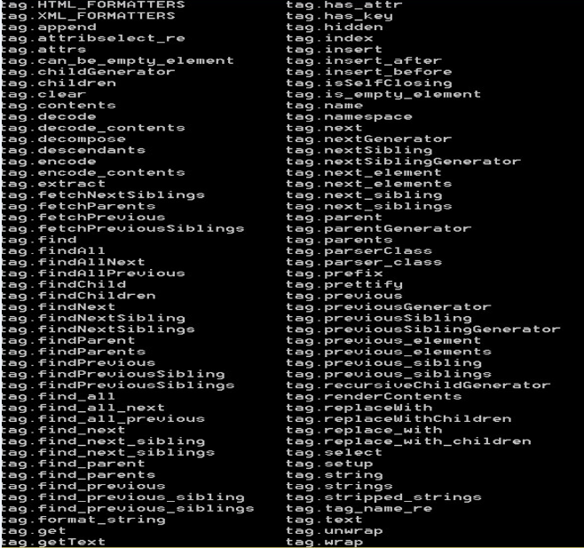
All Supported Operations on TAG Object

Slide 12
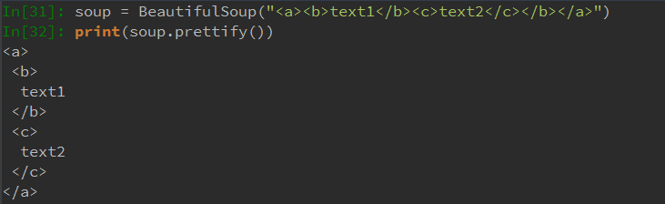
Soup.prettify()
Used When the HTML doc looks jumbled and we want to see it structured by parsing each tag on its own line
It helps to visualize HTML tags in a better way and we can see the parent, children, sibling tags easily
Example html doc:

Slide 13
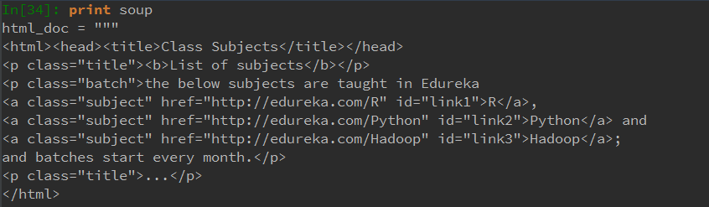
Example HTML Doc For Reference

Slide 14
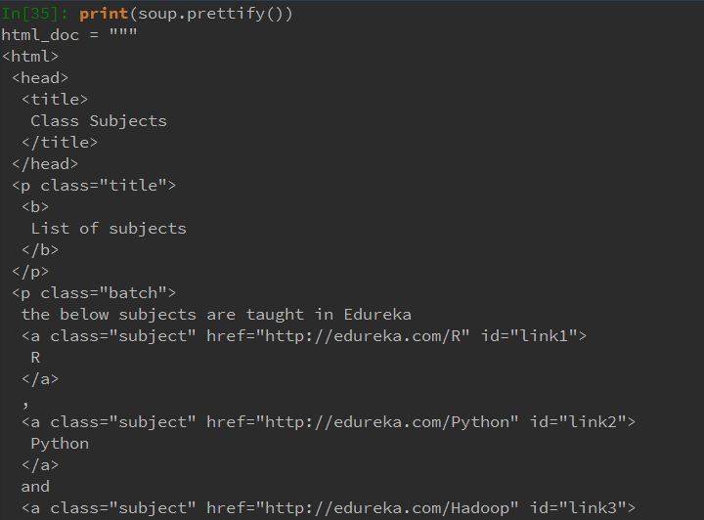
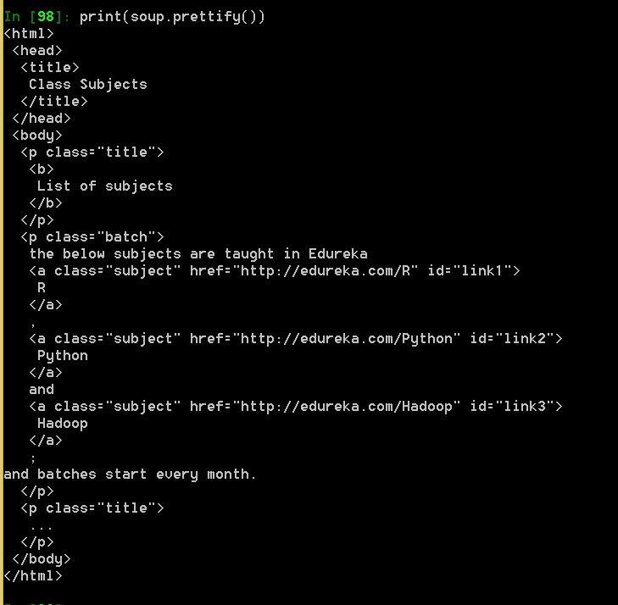
Prettifying the Example

Slide 15
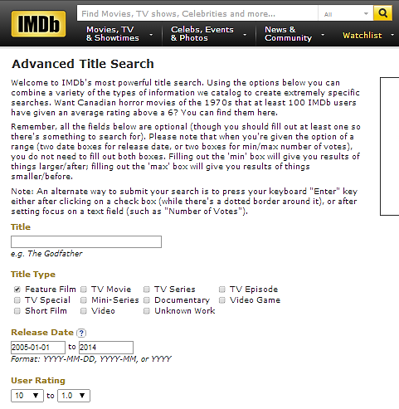
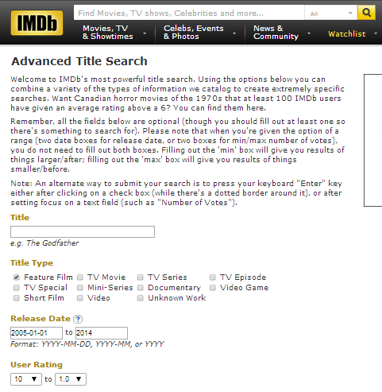
Scraping IMDB Webpage
Lets scrape IMDB to find out Top movies released during 2005 to 2014 sorted by number of user votes. We need to pull title, year, genres, runtime, rating and image source info for the movies
Step 1: Go to the base IMDB search url: http://www.imdb.com/search/title
Step 2: We will use the full url directly built by IMDB website while entering our requirement:
http://www.imdb.com/search/title?sort=num_votes,desc&start=1&title_type=feature&year=2005,2014

Slide 16
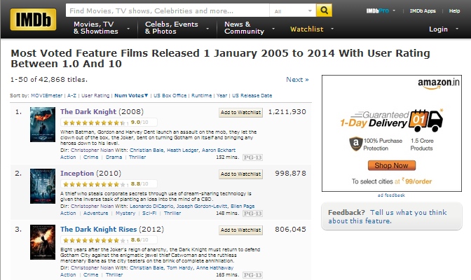
Target Page

Slide 17
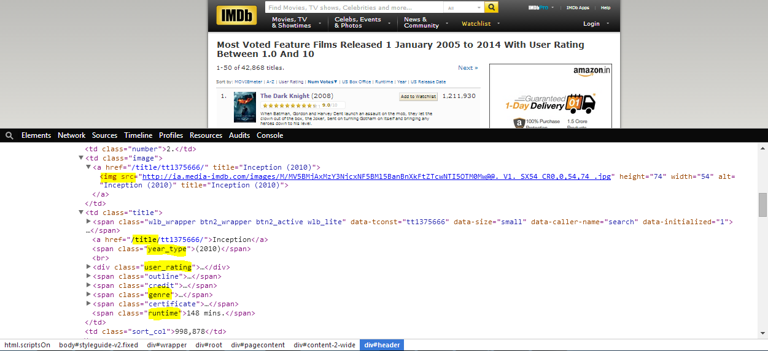
Find the Required Fields in the Source
Step 3:
Right click on the webpage and “inspect element” (In Chrome)
Hover your mouse over the source page at bottom to get the corresponding location in the web page
Example: See the title selected

Slide 18
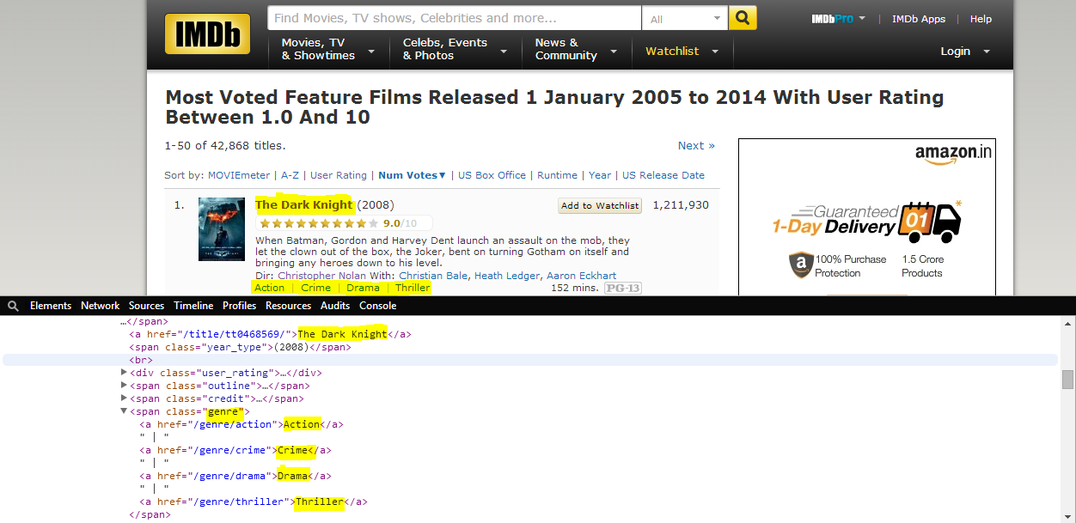
Finding Other Fields
To find “genre” we will have to inspect further down
Since multiple genre possible for one movie, we will have to use it in a loop

Slide 19
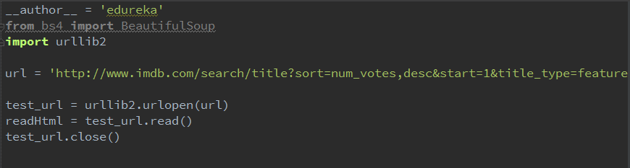
Using the Full url
Step 4:
Access the url
Direct url passing way:
Step 5: Pass to BeautifulSoup
Building Main Logic
Step 6: Formatting the Output

Slide 20
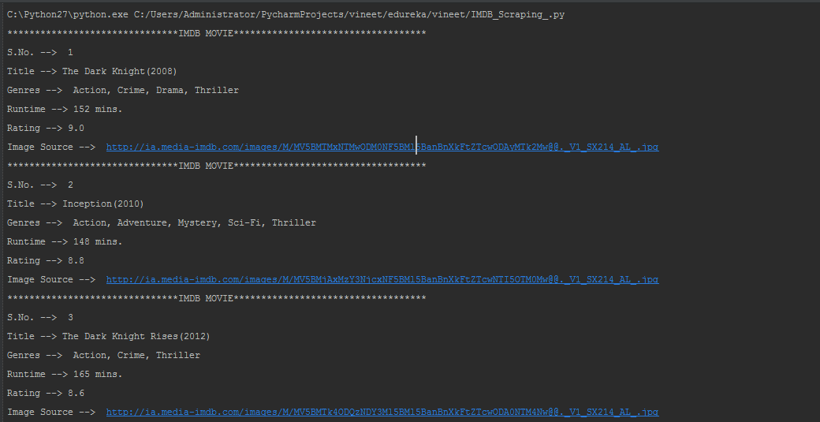
Formatting the Output - Sample Shown

Slide 21

PyDoop – Hadoop with Python
Python can be used to write Hadoop MapReduce programs and applications to access HDFS API for Hadoop with PyDoop package
PyDoop package provides a Python API for Hadoop MapReduce and HDFS
PyDoop has several advantages over Hadoop’s built-in solutions for Python programming, i.e., Hadoop Streaming and Jython
One of the biggest advantage of PyDoop is it’s HDFS API. This allows you to connect to an HDFS installation, read and write files, and get information on files, directories and global file system properties
The MapReduce API of PyDoop allows you to solve many complex problems with minimal programming efforts. Advance MapReduce concepts such as ‘Counters’ and ‘Record Readers’ can be implemented in Python using PyDoop

Slide 22
Demo: Python NLTK on Hadoop
Leveraging Analytical power of Python on Big Data Set. (MR + NLTK)
Perform stop word removal using Map Reduce.

